Slide 1

COMPUTER NETWORKS
Sivaraman Eswaran Ph.D.
Department of Computer Science and Engineering

Slide 2

COMPUTER NETWORKS
Computer Networks and the Internet
Sivaraman Eswaran Ph.D.
Department of Computer Science and Engineering

Slide 3
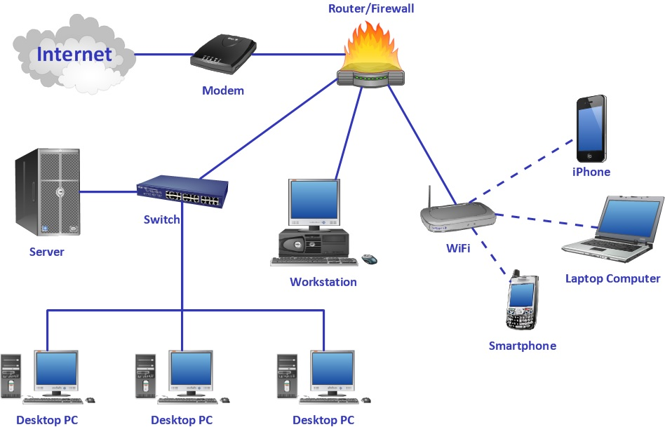
COMPUTER NETWORKS
Introduction to Computer Networks
Two or more devices connected together.
Communicate with each other, share data or resources

Slide 4
COMPUTER NETWORKS
What is the Internet?
A massive network of networks.
A computer network that interconnects billions of computing devices throughout the world.
Traditional devices – PCs, Workstations, Servers – web pages, emails, etc.
Internet “things” – laptops, PDAs, TVs, gaming consoles, home security systems, home appliances, watches, cars, traffic control systems, etc.,

Slide 5









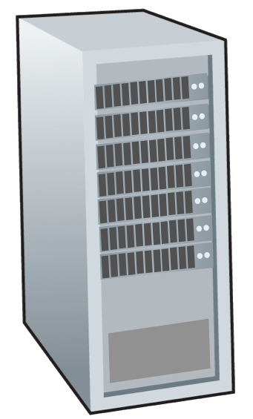






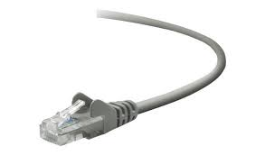
COMPUTER NETWORKS
The Internet: A “Nuts and Bolts” View
Billions of connected computing devices:
hosts = end systems
running network apps at Internet’s “edge”
mobile network
national or global ISP
Packet switches: forward packets (chunks of data)
routers, switches
local or regional ISP
Internet
Communication links
fiber, copper, radio, satellite
transmission rate: bandwidth
home network
content
provider
network
datacenter
network
Networks
collection of devices, routers, links: managed by an organization
enterprise
network

Slide 6




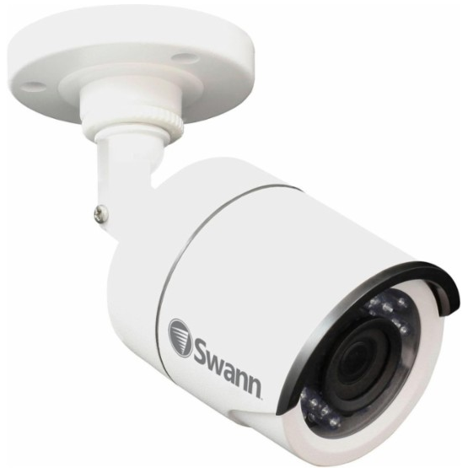
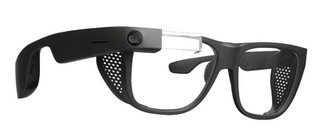


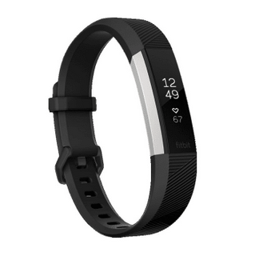
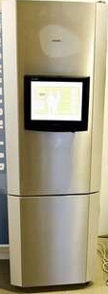
COMPUTER NETWORKS
“Fun” Inter-connected Devices
Tweet-a-watt:
monitor energy use
Others?
Amazon Echo
IP picture frame
Web-enabled toaster +
weather forecaster
Internet
refrigerator
There will be 41 Billion IoT devices by 2027*
Slingbox: remote
control cable TV
Security Camera
AR devices
sensorized,
bed
mattress
Internet phones
Fitbit
* https://www.businessinsider.com/internet-of-things-report?IR=T

Slide 7
COMPUTER NETWORKS
The Internet: A “Nuts and Bolts” View
mobile network
4G
Internet: “network of networks”
Interconnected ISPs
national or global ISP
Protocols are everywhere
control sending, receiving of messages
e.g., HTTP (Web), streaming video, Skype, TCP, IP, WiFi, 4G, Ethernet
Streaming
video
Skype
IP
local or regional ISP
home network
content
provider
network
Internet standards
RFC: Request for Comments
IETF: Internet Engineering Task Force
HTTP
datacenter
network
Ethernet
TCP
enterprise
network
WiFi

Slide 8


COMPUTER NETWORKS
Queries

Slide 9
THANK YOU
Sivaraman Eswaran Ph.D.
Department of Computer Science and Engineering
sivaramane@pes.edu
+91 80 6666 3333 Extn 834

